Slide 1
Interactive Debugging at IP Block Interfaces in FPGAs FPGA ’21
王淼
2021-12-08

Slide 2
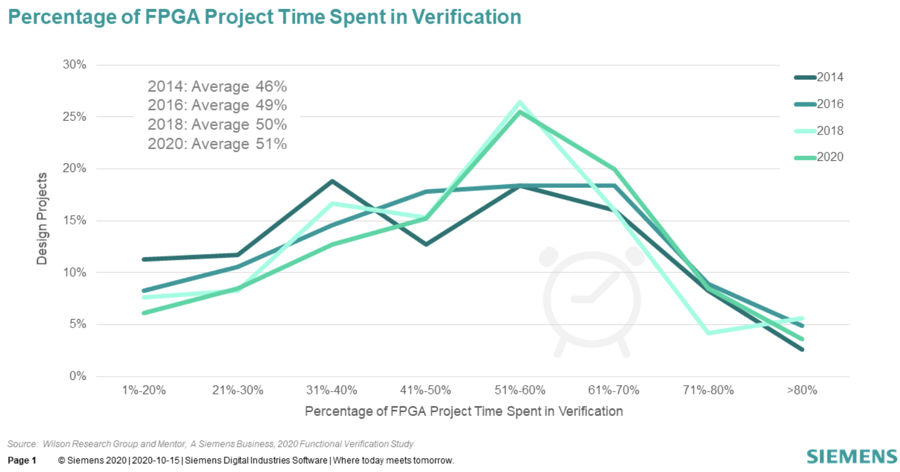
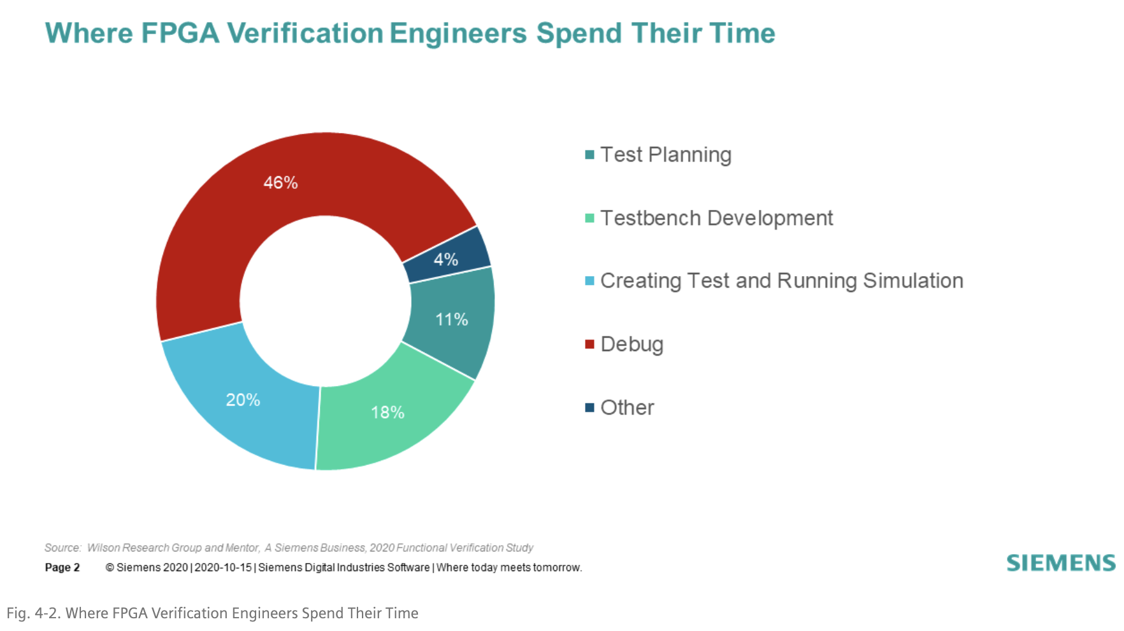
Background
FPGA design complexity increasing → debug time ↑
verification time often takes average 51% of the design cycle
46% of verification time spent on debugging
FPGA deployment in datacenter increasing
Practical and efficient debugging requires immediacy

Slide 3
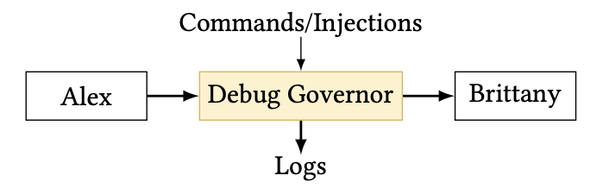
Debug Governor
An approach to FPGA debugging that prioritizes controllability and interactivity
Effective for single FPGAs and scales naturally to multiple FPGAs in a data center application
PLDI Operations
Pause
Log
Drop
Inject

Slide 4
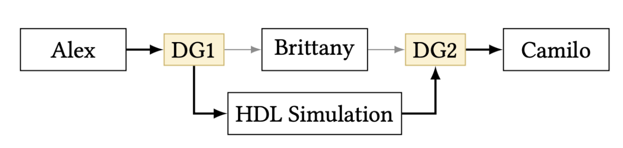
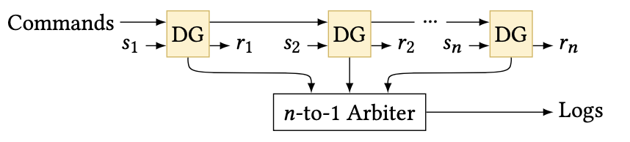
Debug Method
Applying several PLDI operations simultaneously
Single-stepping
DG includes a controller that can automatically re-enable Pausing after exactly 𝑛 messages are Logged
Redirect to HDL Simulation
DG network

Slide 5
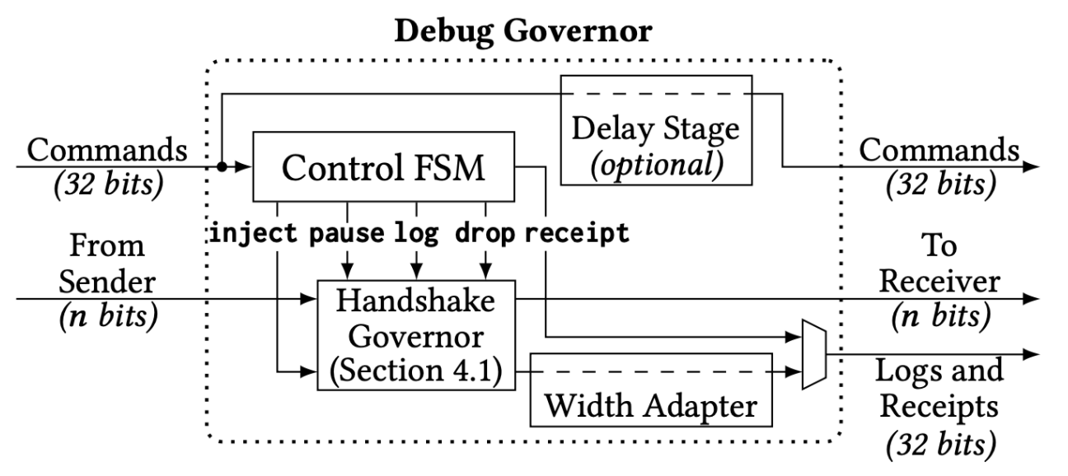
Infrastructure

Slide 6
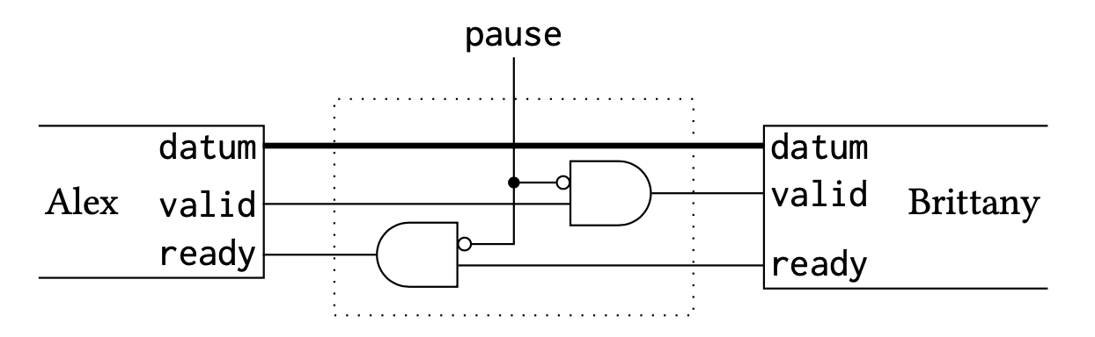
Handshake Governor : Pause Circuit
Pause: prevent sender from sending data
Pause signal high
Brittany_valid always low
Alex_ready always low
Pause signal low
Valid, ready stay unchanged

Slide 7
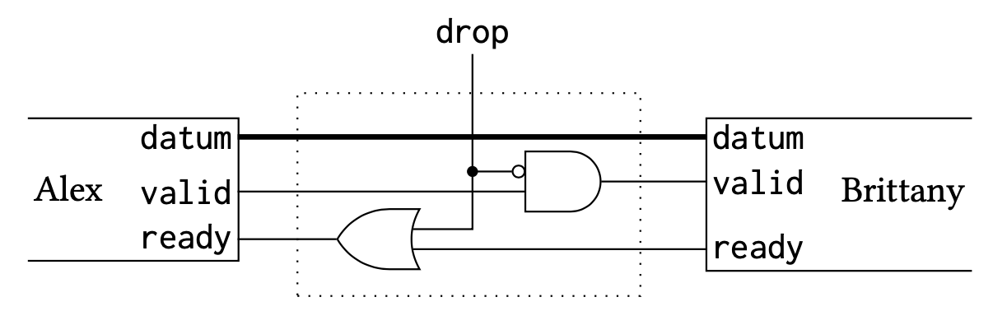
Handshake Governor : Drop Circuit
Drop: Sender is allowed to send data, but never sent to Receiver
Drop signal high
Brittany_valid always low
Alex_ready always high
Drop signal low
Valid, ready stay unchanged

Slide 8
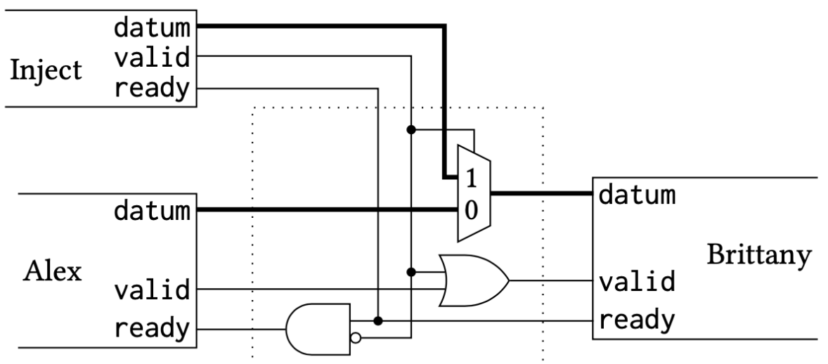
Handshake Governor : Inject Circuit
Inject: Data from the Governor’s inject input are sent to Receiver, pausing Sender if necessary.
Inject_valid signal high
Receive datum from Inject block
Brittany_valid high
Alex_ready stays low
Inject_valid signal low
datum, valid, ready stay unchanged

Slide 9
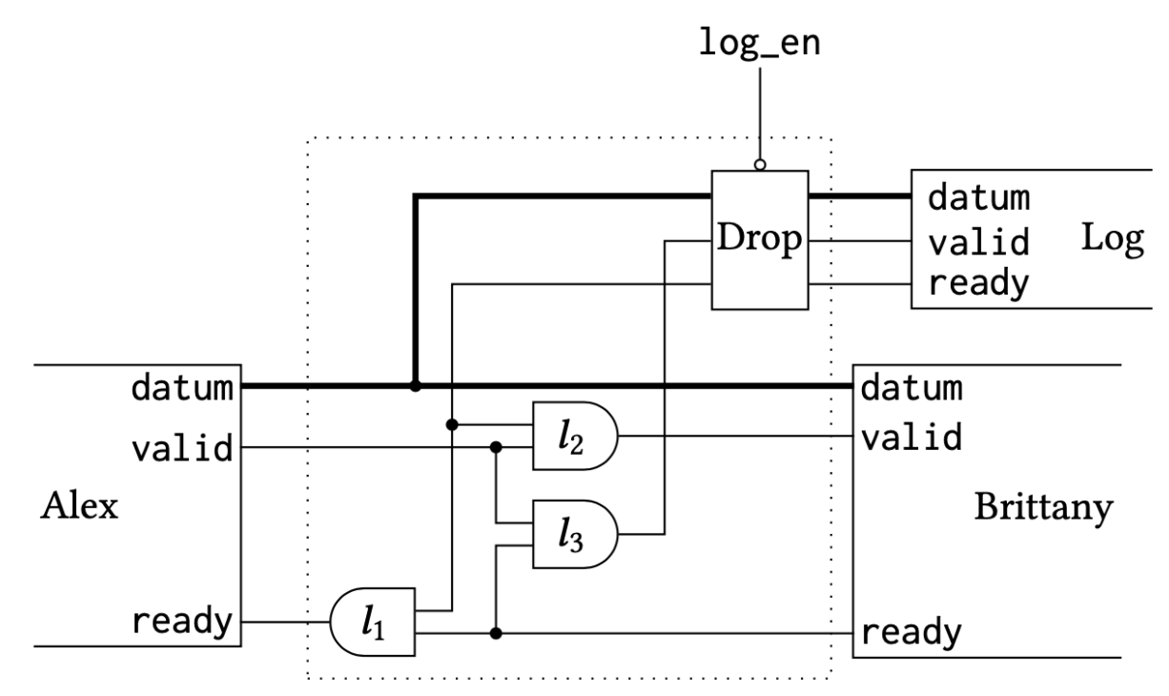
Handshake Governor : Log Circuit
Log: All data sent from Sender are duplicated and sent to the Governor’s log output
Log_en signal high
Drop block don’t work
L1 ensure Alex send data when both Log and Brttany are ready
L2, L3 ensure data never sent to just one of the receivers
Inject_valid signal low
Log_valid stays low

Slide 10
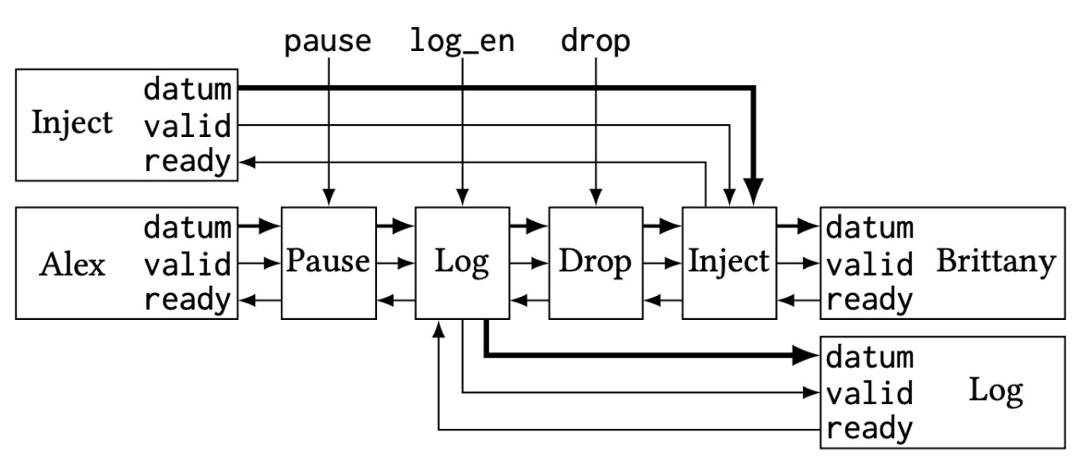
PLDI Operations Order
When Pause-ing, nothing can be Logged or Dropped, but Injections can proceed.
When Dropping, Logging and Injecting are still possible.
PLDI satisfy the above properties

Slide 11
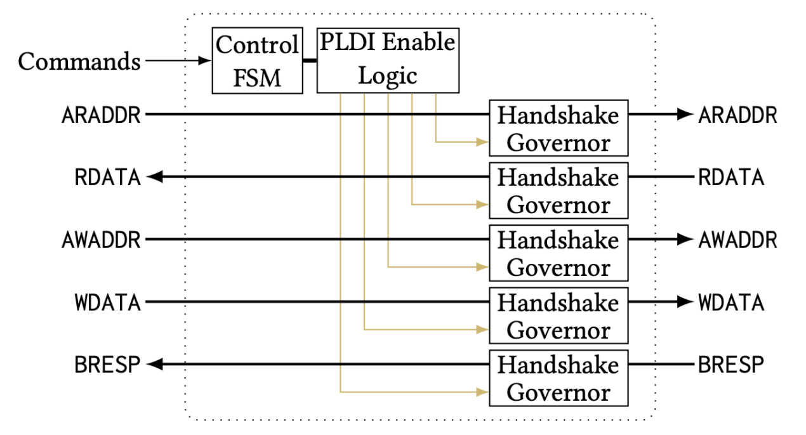
Extension to AXI Lite

Slide 12
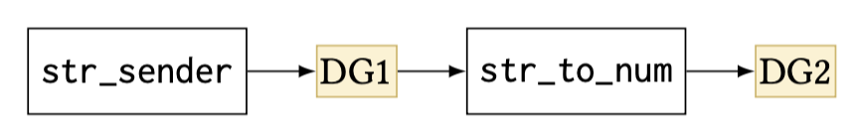
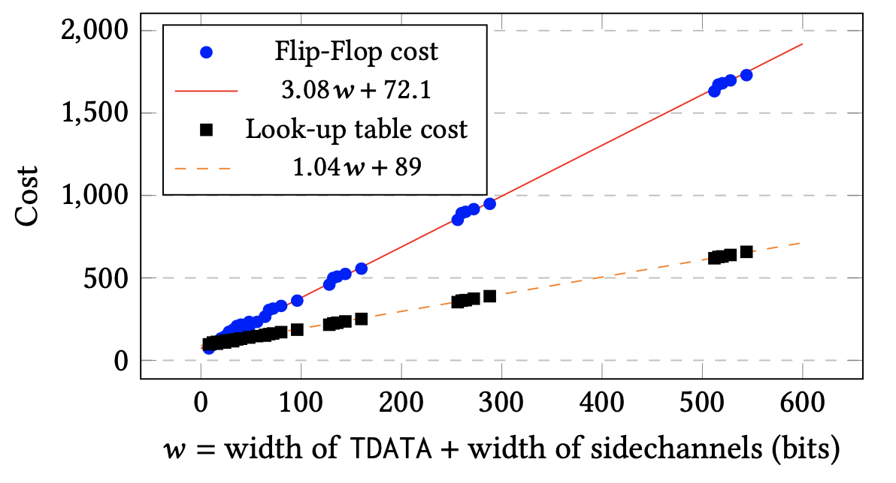
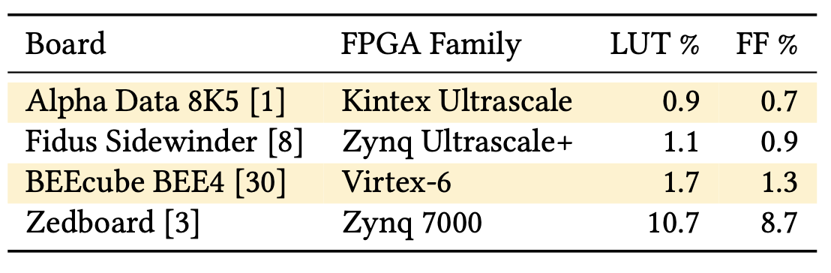
Evaluation
Functional:
Use String-to-Number Converter as debug example
Performance:
Delay: 1 lut on LUT6 FPGA
Inject Speed: 1KB/s
Log Speed: 55KB/s
Resources
𝑤 + 89 LUTs, 3𝑤+72 FFs
For a deign with 30 DG, 5000 LUT and 8500 FFs
30-to-1 arbiter: 690 LUTs, 730 FFs

Slide 13
Conclusion
A Debugger with controllability and interactivity
Can support other commonly-used memory-mapped buses
Future work:
add a transparent Logging mode that never applies backpressure, but may not log every single frame
add a Logging mode that simply counts frame instead of Logging actual data

